Slide 1
Web application security: Lecture Outline
What is web application security (WAS)?
Importance of WAS, Key components of WAS
Common WAS vulnerabilities-
Injection attack, broken authentication,sensitive data exposure, XML external entities, Broken access control, cross site scripting, security misconfiguration, insufficient logging and monitoring etc.
Web application firewalls (WAFs)
Types of WAF based on working principles and based on deployment model.
Key functions of WAF
Key features of WAF
Popular WAFs
Benefits of WAFs
Challenges of WAFs

Slide 2
What is Web Application Security?
Web Application Security refers to the practices, technologies, and processes used to protect web applications from cyber threats, vulnerabilities, and attacks.
Or
Web application security focuses on protecting websites, applications, and APIs from attacks by implementing security measures and best practices throughout the software development lifecycle.
The goal of web application security is to ensure that web applications function as intended, protect sensitive information, and remain resilient against malicious activities.

Slide 3
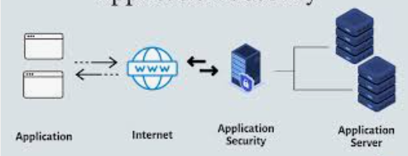
What is Web Application Security?

Slide 4
Importance of Web Application Security (WAS)
Web applications are accessible over the internet, they are exposed to a wide range of threats. Key reasons why web application security is essential include:
1. Protecting Sensitive Data:
Web applications often handle sensitive information such as personal data, financial details, and login credentials. A breach can lead to identity theft, financial loss, or legal consequences.
2. Maintaining User Trust:
Security incidents can damage an organization's reputation and erode user confidence.
3. Preventing Financial Loss:
Cyberattacks can result in direct financial losses, regulatory fines, and recovery costs.
4. Ensuring Compliance:
Many industries are subject to regulations (e.g., GDPR, PCI DSS) that mandate specific security measures for web applications.

Slide 5
Key Components of WAS

Slide 6
Key Components of WAS
Web application security encompasses multiple layers of protection, including:
1. Application Layer Security
Focuses on securing the code and functionality of the web application.
Addresses vulnerabilities like SQL injection, cross-site scripting (XSS), and insecure APIs.
Involves secure coding practices, input validation, and output encoding.
2. Network Layer Security
Protects data in transit between the user and the web application.
Uses encryption protocols like TLS/SSL to secure communication.
Implements firewalls and intrusion detection/prevention systems (IDS/IPS).

Slide 7
Key Components of WAS
3. Infrastructure Security
Secures the servers, databases, and other infrastructure components that host the web application.
Includes patch management, secure configurations, and access controls.
4. Authentication and Authorization
Ensures that only legitimate users can access the application and its resources.
Implements strong authentication mechanisms (e.g., multi-factor authentication) and role-based access controls (RBAC).
5. Data Security
Protects sensitive data stored or processed by the application.
Uses encryption for data at rest and in transit, and secure storage practices.

Slide 8
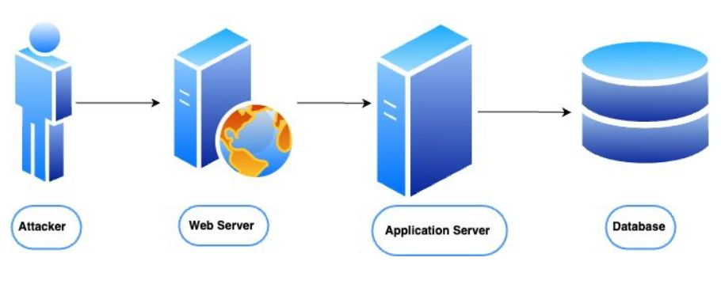
Common web application vulnerabilities

Slide 9
Common web application vulnerabilities
1. Injection Attacks
2. Broken Authentication
3.Sensitive Data Exposure
4. XML External Entities (XXE) injection
5. Broken Access Control
6. Security Misconfigurations
7. Cross-Site Scripting (XSS)
8. Insufficient Logging and Monitoring

Slide 10
Injection Attacks
Injection vulnerabilities occur when untrusted data is sent to an interpreter as part of a command or query, leading to unintended execution of malicious commands.
Examples:
SQL Injection: Attackers inject malicious SQL queries into input fields (e.g., login forms) to manipulate or extract data from databases.
Command Injection: Exploiting system commands through vulnerable inputs to execute arbitrary commands on the server.
LDAP Injection: Manipulating Lightweight Directory Access Protocol (LDAP) queries to gain unauthorized access to directory services.
Impact:
Unauthorized access to databases.
Data theft, modification, or deletion.
Complete system compromise.
Prevention:
Use parameterized queries or prepared statements.
Validate and sanitize all user inputs.
Employ ORM (Object-Relational Mapping) frameworks.

Slide 11
Broken Authentication
This vulnerability occurs when authentication mechanisms are improperly implemented, allowing attackers to compromise user accounts.
Examples:
Weak passwords or lack of password complexity requirements.
Session hijacking through insecure session management.
Storing credentials in plaintext or using weak hashing algorithms.
Impact:
Unauthorized access to user accounts.
Identity theft and privilege escalation.
Prevention:
Implement multi-factor authentication (MFA).
Use strong password policies and secure password storage (e.g., bcrypt).
Secure session management with proper timeout and invalidation.

Slide 12
Sensitive Data Exposure
This vulnerability arises when sensitive data (e.g., passwords, credit card numbers) is not adequately protected, making it accessible to attackers.
Examples:
Transmitting sensitive data over unencrypted channels (HTTP instead of HTTPS).
Storing sensitive data in plaintext or using weak encryption.
Exposing sensitive data in error messages or logs.
Impact:
Data breaches and theft of sensitive information.
Regulatory penalties and reputational damage.
Prevention:
Use strong encryption (e.g., AES for data at rest, TLS for data in transit).
Avoid storing unnecessary sensitive data.
Mask sensitive data in logs and error messages.

Slide 13
XML External Entities (XXE) injection
XML, or Extensible Markup Language, is a markup language and file format used to store, transport, and reconstruct data, allowing for structured data exchange between different systems.
Some applications use the XML format to transmit data between the browser and the server. Applications that do this virtually always use a standard library or platform API to process the XML data on the server.
XXE vulnerabilities arise because the XML specification contains various potentially dangerous features, and standard parsers support these features even if they are not normally used by the application.

Slide 14
XML External Entities (XXE) injection
XXE vulnerabilities occur when an application processes XML input containing external entity references, which can be exploited to access internal files or execute remote requests.
Impact:
Unauthorized access to internal files.
Server-side request forgery (SSRF) attacks.
Denial of service (DoS).
Prevention:
Disable external entity processing in XML parsers.
Use safer data formats like JSON.
Validate and sanitize XML inputs

Slide 15
Broken Access Control
Access control vulnerabilities occur when restrictions on what authenticated users areallowed to do are not properly enforced.
Examples:
Insecure Direct Object References (IDOR): Manipulating object references (e.g., URLs) to access unauthorized resources.
Missing or improper role-based access controls (RBAC).
Impact:
Unauthorized access to sensitive data or functionality.
Privilege escalation.
Prevention:
Implement proper access controls and RBAC.
Validate user permissions for every request.
Avoid exposing internal object references in URLs.

Slide 16
Security Misconfigurations
This vulnerability arises when security settings are not properly configured, leaving the application exposed to attacks.
Examples:
Using default credentials or configurations.
Enabling unnecessary features or services.
Exposing sensitive information in error messages.
Impact:
Unauthorized access to systems or data.
Exploitation of unused features.
Prevention:
Regularly review and harden configurations.
Disable unnecessary features and services.
Use automated tools to detect misconfigurations

Slide 17
Cross-Site Scripting (XSS)
XSS vulnerabilities occur when an application includes untrusted data in a web page without proper validation or escaping, allowing attackers to execute malicious scripts in the browser of other users.
Types:
Stored XSS: Malicious scripts are permanently stored on the server (e.g., in a database).
Reflected XSS: Malicious scripts are reflected off the web server (e.g., in search results).
DOM-based XSS: The vulnerability exists in the client-side code (e.g., JavaScript).
Impact:
Session hijacking.
Defacement of websites.
Malware distribution.
Prevention:
Validate and sanitize user inputs.
Use Content Security Policy (CSP) headers.
Encode output to prevent script execution

Slide 18
Insufficient Logging and Monitoring
Inadequate logging and monitoring make it difficult to detect and respond to security incidents.
Impact:
Delayed detection of breaches.
Increased damage from attacks.
Prevention:
Implement comprehensive logging and monitoring.
Use SIEM (Security Information and Event Management) tools.
Regularly review logs for suspicious activity.
Understanding and addressing common web application vulnerabilities is essential for building secure applications. By following secure coding practices, conducting regular security testing, and staying informed about emerging threats,

Slide 19
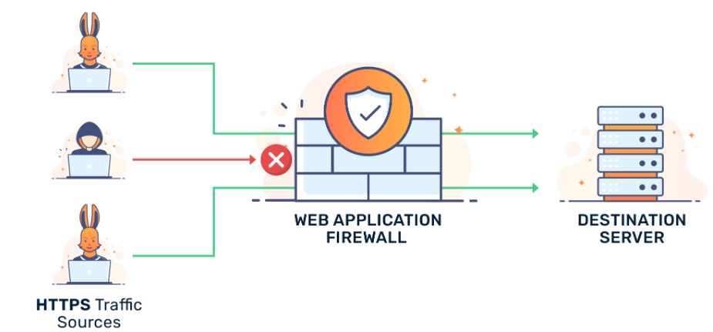
Web Application Firewalls (WAFs)

Slide 20
Web Application Firewalls (WAFs)
Web Application Firewalls (WAFs) are security solutions designed to protect web applications by monitoring, filtering, and blocking malicious HTTP/HTTPS traffic.
They act as a shield between the web application and the internet, defending against a wide range of attacks, such as SQL injection, cross-site scripting (XSS), and distributed denial-of-service (DDoS) attacks.
They WAFs are a critical component of a comprehensive web application security strategy.

Slide 21
Types Web Application Firewalls (based on deployment)
WAFs operate by analyzing incoming and outgoing web traffic and applying a set of rules or policies to detect and block malicious activity. They can be deployed in several ways:
Network-Based WAFs: Hardware appliances installed on-premises, typically placed in front of web servers.
Host-Based WAFs: Software modules integrated into the web server or application.
Cloud-Based WAFs: Managed services provided by third-party vendors, offering scalability and ease of deployment.

Slide 22
Types of Web Application Firewalls (Based on Working principles)
WAFs can be categorized based on their deployment model and operational approach:
1. Signature-Based WAFs
Use a database of known attack patterns (signatures) to detect and block threats.
Effective against known vulnerabilities but may struggle with zero-day attacks.
Example: ModSecurity with OWASP Core Rule Set (CRS).
2. Behavior-Based WAFs
Analyze traffic behavior to identify anomalies and potential threats.
Effective against zero-day attacks and unknown vulnerabilities.
Example: Cloudflare WAF.

Slide 23
Types of Web Application Firewalls (Based on Working principles)
3. Positive Security Model
Allows only known good traffic based on predefined rules.
Highly secure but can be complex to configure and maintain.
4. Negative Security Model
Blocks known bad traffic based on predefined rules.
Easier to implement but may miss new or unknown threats.

Slide 24
Key Functions of a WAF
Traffic Inspection: Analyzes HTTP/HTTPS requests and responses for malicious patterns.
Rule-Based Filtering: Uses predefined rules (signatures) to identify and block known threats.
Behavioral Analysis: Detects anomalies in traffic patterns that may indicate an attack.
Logging and Reporting: Provides detailed logs and reports for monitoring and auditing.
Real-Time Protection: Blocks attacks in real-time without disrupting legitimate traffic.

Slide 25
Key Features of a WAF
A robust WAF should include the following features:
1. Threat Detection and Prevention:
Protects against OWASP Top 10 vulnerabilities (e.g., SQL injection, XSS).
Mitigates DDoS attacks and brute-force attempts.
2. Customizable Rules:
Allows administrators to create custom rules for specific application needs.
3. SSL/TLS Offloading:
Decrypts and inspects encrypted traffic for hidden threats.
4. Bot Mitigation:
Identifies and blocks malicious bots while allowing legitimate traffic.
5. API Security:
Protects APIs from abuse and exploitation.
6. Real-Time Monitoring and Alerts:
Provides real-time visibility into traffic and security events.
7. Integration with Other Security Tools:
Works seamlessly with SIEM (Security Information and Event Management) and other security solutions.

Slide 26
Popular Web Application Firewalls
1. Cloud-Based WAFs:
Cloudflare: Offers a global network with DDoS protection and bot mitigation.
AWS WAF: Integrated with Amazon Web Services, providing scalable protection.
Akamai Kona Site Defender: Provides advanced threat detection and mitigation.
2. On-Premises WAFs:
F5 BIG-IP ASM: A hardware-based WAF with advanced security features.
Imperva SecureSphere: Offers comprehensive protection for web applications and databases.
3. Open-Source WAFs:
ModSecurity: A widely used open-source WAF with the OWASP Core Rule Set.
NAXSI: An open-source WAF for NGINX.

Slide 27
Benefits of Using a WAF
1. Protection Against Common Threats:
Defends against attacks like SQL injection, XSS, and CSRF.
2. Improved Compliance:
Helps meet regulatory requirements like PCI DSS, GDPR, and HIPAA.
3. Reduced Risk of Data Breaches:
Prevents unauthorized access to sensitive data.
4. Enhanced Performance:
Offloads security processing from web servers, improving performance.
5. Scalability:
Cloud-based WAFs can scale to handle high traffic volumes.
6. Ease of Deployment:
Cloud-based WAFs can be deployed quickly without hardware changes.

Slide 28
Challenges of Using a WAF
1. False Positives and Negatives:
Legitimate traffic may be blocked (false positives), or malicious traffic may be allowed (false negatives).
2. Complex Configuration:
Customizing rules and policies can be time-consuming and requires expertise.
3. Performance Overhead:
Network-based WAFs may introduce latency.
4. Cost:
Hardware-based WAFs and advanced cloud-based solutions can be expensive.

